Slide 1
Online News Content Neural
Network Recommendation Engine
Insider Inc.
Curly Wu, Tao Wen, Sam Tang
Project 12, Group 21

Slide 2
Research Question/Objective
Objective
Problem definition
Match each Article with the Best Video to eventually boost revenues
Explore how Neural Networks can improve Article-Video Recommendation beyond Cosine Similarity of LLM embeddings in production
Train a Neural Network that tackles the Top1 Recommendation problem
Maintain good match quality while increasing the match rate
Data
We have a repository of 23k Articles and 6.3k Videos (with Summary, Vertical, fixed Embedding, etc.)
We are NOT allowed to change Embeddings
We have only 5.5k (Article, Video) pairs labeled as good or bad match

Slide 3
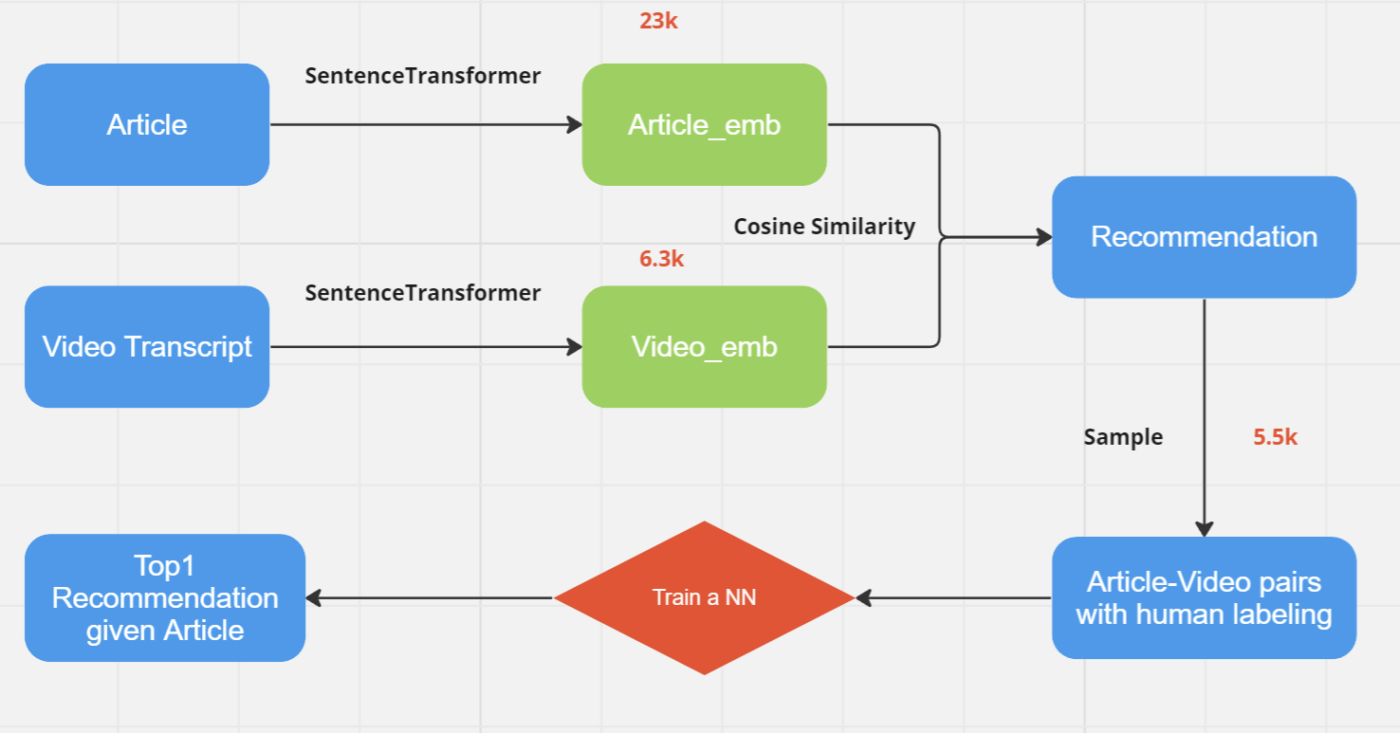
Flow diagram

Slide 4
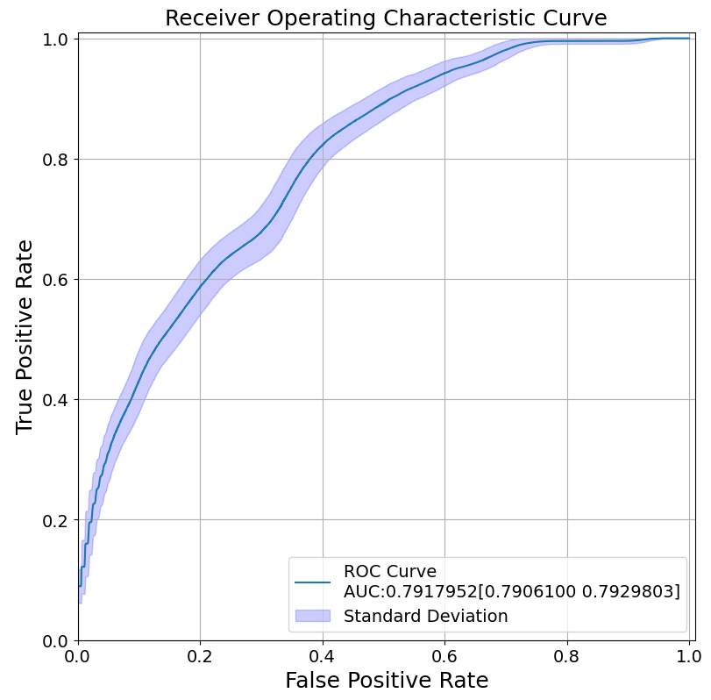
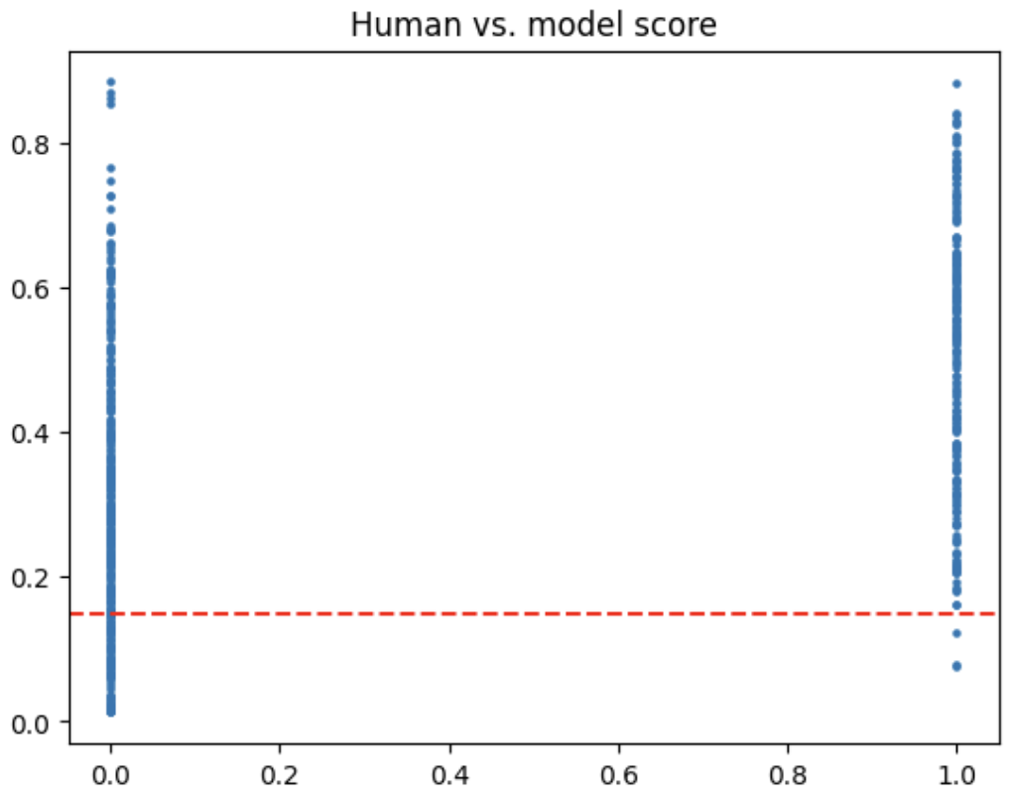
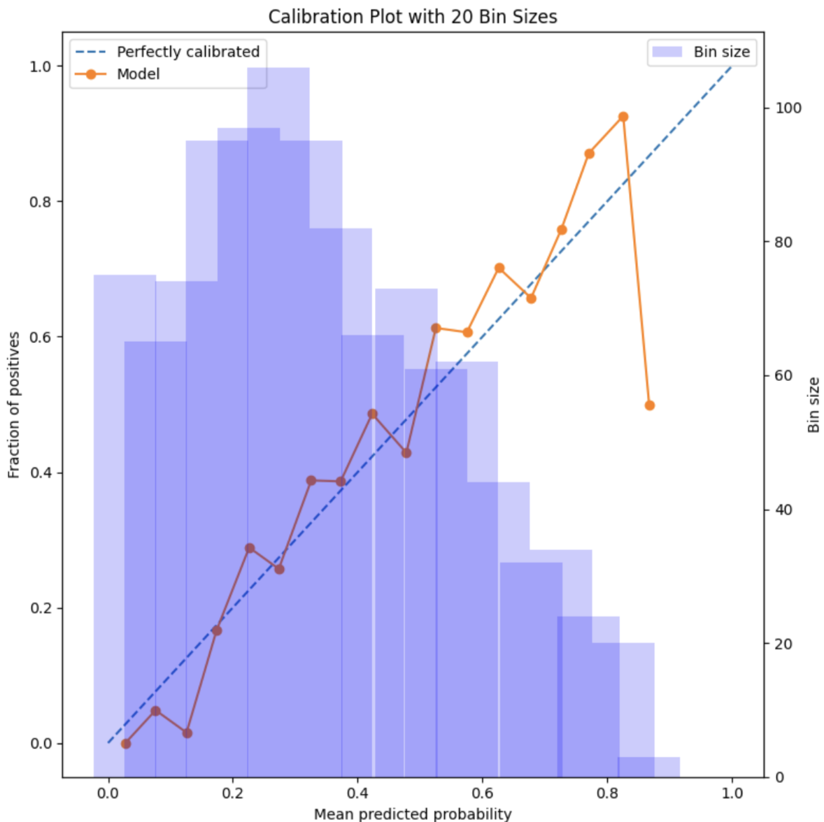
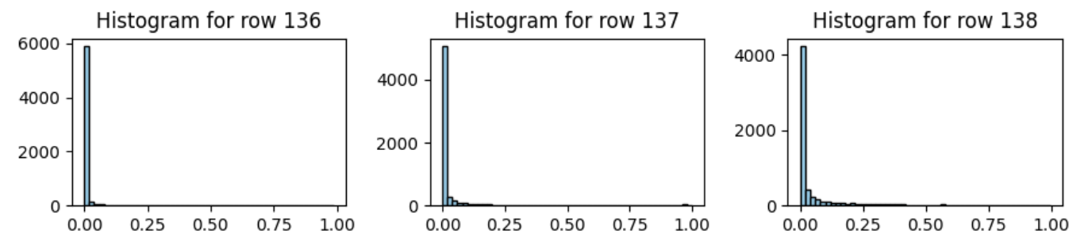
Progress
Used good/bad classification as a proxy task for computing article-video scores
Implemented a baseline MLP classifier that avoids overfitting
Classification performance & Score distribution:
Current Match rate: 84.12% & Quality rate: 45.06%
Notes:
Given the data we have, our first approach was to use the binary classification of good and bad as a proxy for the recommendation task, hoping that the scores produced by the classifier could be directly used for ranking videos for a given article. As the data size is very small, we implemented a baseline MLP classifier to avoid overfitting. As we can see from the plots here, the model achieves good performance in classification, in terms of both AUC and calibration. It also differentiates the scores for good and bad matches to some degree, however as our task is Top-1 recommendation, it still struggles to maintain both high match rate and quality rate at the same time. Actually the current metrics in production are both over 80%, significantly higher than what we have achieved so far.

Slide 5
Planned Experiments/Tests & Timeline
Future steps:
Adding features: we’ve only used the given embeddings so far.
Data augmentation: leverage ChatGPT to label more pairs or generate more text given examples and a proper prompt.
Unsupervised learning: labeled data is limited but we have a large amount of data with features - contrastive learning may be worth a try.
Timeline:
Nov: excluding Thanksgiving, 1 week for each step.
Dec: wrap up and write report.

